Slide 1

Myntra fashion
Exploratory data analysis
Submitted By: Roshani Srivastava

Slide 2
About
Myntra is a major Indian fashion e-commerce company headquartered in Bengaluru, Karnataka, India. The company was founded in 2007-2008 to sell personalized gift items. In May 2014, Myntra.com was acquired by Flipkart
In May 2022, Myntra launched an express delivery service on its app to offer one of a kind of experience by fashion & beauty platform. This service allow shoppers to receive their orders for products marked with ‘M-express tag’ on the listing page within 24–48 hours of purchase.

Slide 3
About
Type of site : E-Commerce
Available in : English
Area served : India
Founder(s) : Mukesh Bansal, Vineet Saxena, Ashutosh Lawania
CEO : Nandita Sinha
Parent : Flipkart
Subsidiaries : Fitiquette, Roadster
URL : www.myntra.com
Commercial : Yes
Registration : Required
Launched : 2007, 15 years ago
Current status : Active

Slide 4
Aim
Myntra is a major Indian fashion e-commerce company headquartered in Bengaluru, Karnataka, India.] The company was founded in 2007 to sell personalized gift items. In May 2014, Myntra.com was acquired by Flipkart.
We will be using data science skills to identify the apparel type that customers favours and their prices. To identify the parameter that attracts customers to make purchase.
Is it number of images, or colours, or brand name or price?

Slide 5
Problem Statement
The Myntra have shared the dataset with you to identify the attributes to increase sales. You are working as Lead consultant and your key role is to identify the parameters that are extremely important while making a decision.
As a Lead consultant you also have to show the results to your client and managers so it’s advised to create charts while you perform analysis and write down the insights in some separate sheet that you can refer later on.
Some of the problems can be easily identified while solving the scenarios and tasks shared here but you are also required to further share your key points in the Conclusion.
Exploratory Data Analysis (EDA) is an approach to analysing data sets to summarize the main characteristics of data by often using statistical graphs and other visualization methods such as by the use of statistical graphs.

Slide 6
Learning Outcome
Pandas Joins and Merge
Data Manipulation
Data cleaning
Creating charts and bars
Perform wrangling operations to draw more insights
Evaluation of bi-columns on the basis of next attribute
Creating new columns to drill down on analysis

Slide 7
Skill Requirement
numpy
pandas
matplotlib
seaborn

Slide 8
Task 1
Import all the relevant packages (Eg: Numpy, Seaborn...)
Import the datasets into the python environment.
Check the structure, statistics and other important functions. (Only observe the changes)

Slide 9
Task 2(Data Cleaning)
Drop the duplicate data
Check for missing values

Slide 10
Task 3
There is a column that needs string strip operation. Identify that and apply it.
Fill the missing value by ‘Others’ in the column containing it
Since all the column names are single word so you can convert the ‘Price (INR)’ also to single name ‘Price’.
Analyse the Gender column and include your viewpoints how to make it useful.

Slide 11
Exploratory Data Analysis
Performed EDA On the various column in the dataset with following analysis:
Top 10 Brands
Top 10 Expensive brands
Most preferable color

Slide 12
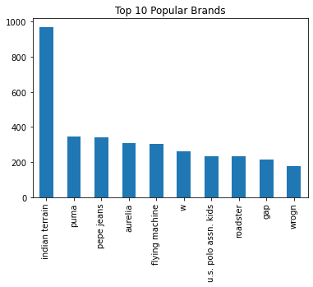
Top 10 Brands
Top 10 Brands are:
Indian Terrain
Puma
Pepe Jeans
Aurelia
Flying Machine
W
U.S. Polo Assn. Kids
Roadster
Gap
Wrogn

Slide 13
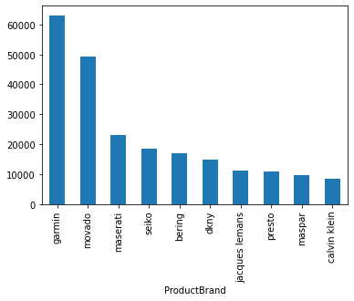
Top 10 Expensive Brands
Garmin
Movado
Maserati
Seiko
Bering
DKNY
Jacques Lemans
Presto
Maspar
Calvin Klein

Slide 14
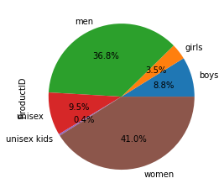
Lets see which product belongs to which category according to gender
Most of the product category in data belongs to women(almost 41%)

Slide 15
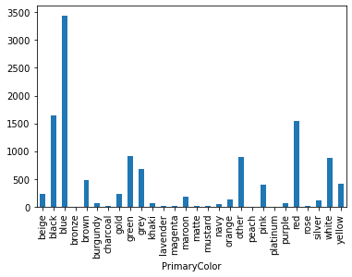
Most Preferable Color
Blue
Black
Red
Green
Rest Come in Others

